Slide 1
Computer networks

Slide 2

computer network
A computer network is a medium that allows two or more computers to be connected in order to communicate with each other

Slide 3
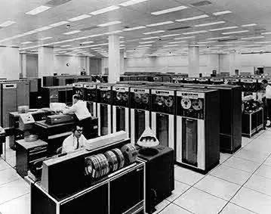
The beginnings of computer networks, MainFrame computers, minicomputers

Slide 4
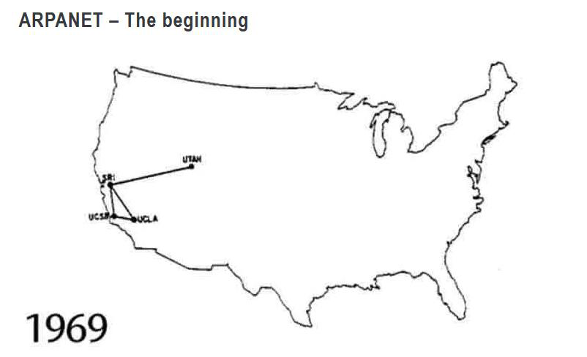
The first computer networks - ARPANET
The original ARPANET connected computers at Stanford, the University of California at Los Angeles (UCLA), the University of California at Santa Barbara (UCSB) and the University of Utah, with the first node installed at UCLA's Network MeasurementsCenter.

Slide 5
Network types
WAN (Wide Area Network)
MAN (Metropolitan Area Network)
Campus (university, academic)
LAN (LocalAreaNetwork)
PAN (PrivateAreaNetwork)

Slide 6
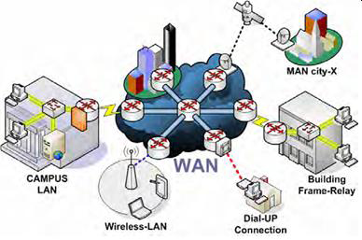
WAN
Wide area networks are primarily characterized by long connections located over a relatively large area, such as a province, country, continent or the entire globe.

Slide 7
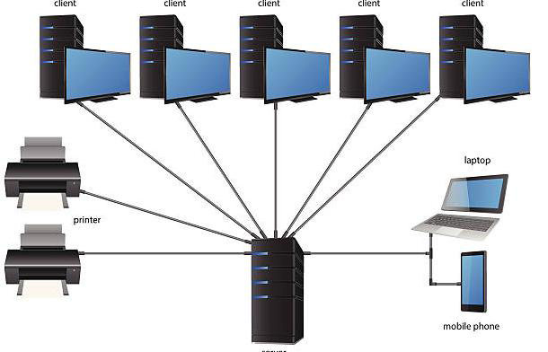
LAN
Local networks concern installations located in a relatively small area. The theoretical diameter of a local network can be up to several hundred meters, but after taking into account the geometry of the rooms, the installation area is limited to one building or its part, e.g. a floor. In local networks, short links (up to approx. 100m) with high capacity or solutions based on radio technology are used. Local networks are also characterized by high operational reliability

Slide 8
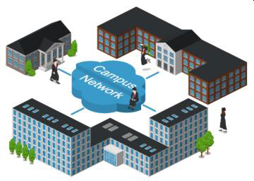
campus networks
In the case of universities, a solution is usually used that consists in connecting individual, internal local networks with links characteristic of the techniques used in the construction of local, not wide-area computer networks.

Slide 9
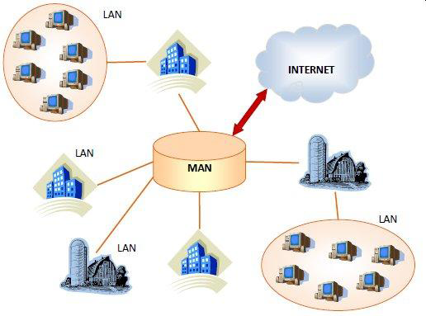
MAN
Metropolitan networks resemble both campus networks and wide area networks in their structure. Their task is to connect many local networks located within the urban agglomeration, which is still a relatively small area. However, in this case, due to formal and security considerations, these connections are generally typical of wide area networks. In addition, the tasks of metropolitan networks include connecting individual computers, mainly private individuals, to the Internet.

Slide 10
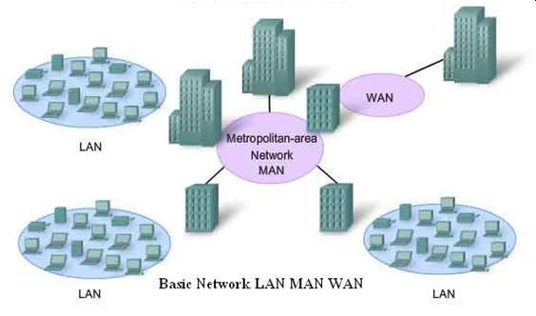
LAN MAN WAN - comparison

Slide 11
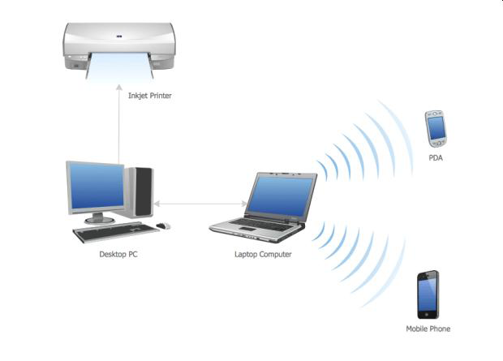
PAN
Private networks (PAN) are structures used mainly in homes and small offices. They are characterized by a small geographical range (up to approx. 10m) and quite a large variety of media, such as: – twisted pair –wireless network –bluetooth –infrared -other

Slide 12
Network topologies
Topology that defines how individual network devices are connected.
The physical network topologies are:
bus,
ring,
double ring,
stars,
extended star,
hierarchical,
nets.

Slide 13
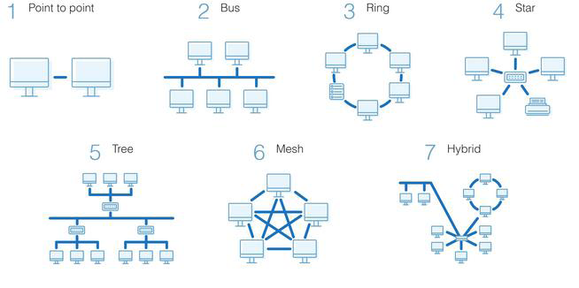
Network topologies

Slide 14
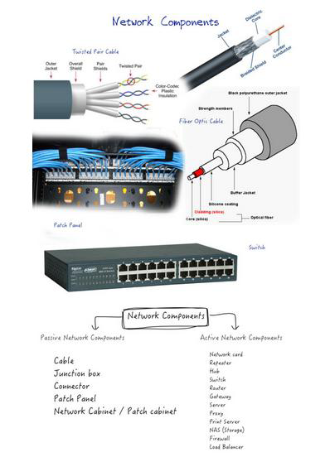
Passive and active network devices

Slide 15
Passive and active network devices
Passive (passive) network devices are all kinds of network peripherals that do not require additional power supply, and those that do not cause changes in the transmitted signals (amplification, filtration, regeneration)
Usually this group includes signal carriers, ie network cables, optical fibers, connectors and others

Slide 16
Passive and active network devices
Active devices are all kinds of peripherals that have the ability to process signals, i.e. amplification, filtration, switching, combining transmission at the interface of different media, etc.,
Active devices require power, these include e.g. Routers, switches, signal repeaters, gateways, bridges, modems, access points and more

Slide 17
Examples of network devices
Modems
Wired and wireless network cards
Converters
Hubs
WLAN access points
Routers

Slide 18
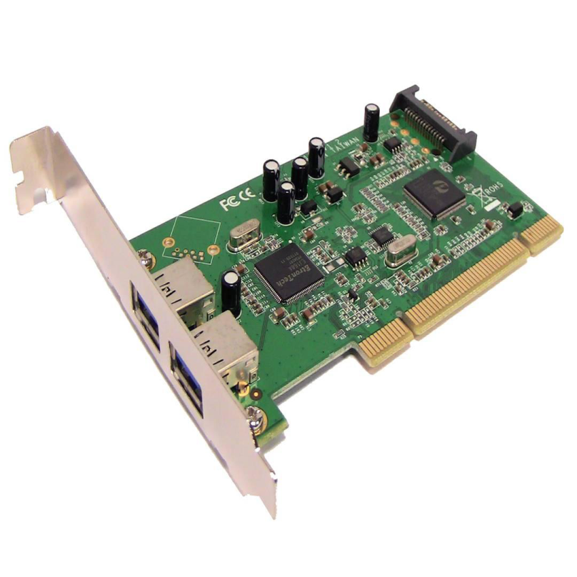
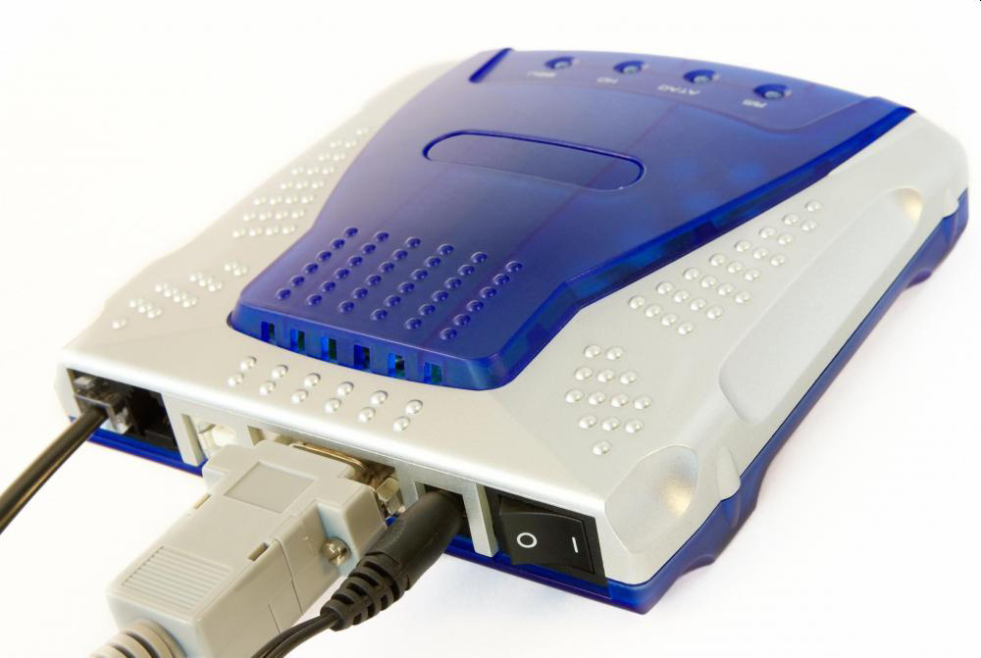
Modem

Slide 19
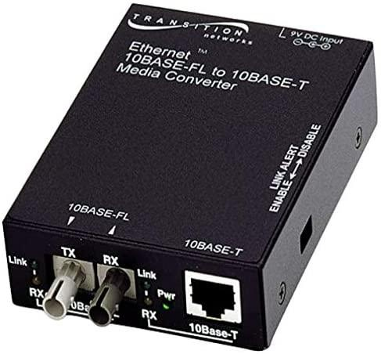
Converters

Slide 20
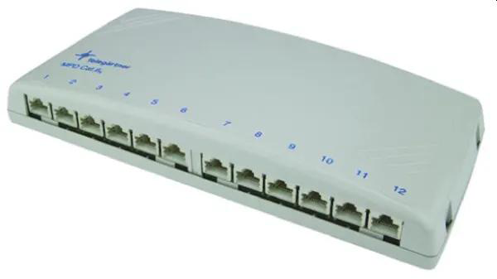
Hub

Slide 21
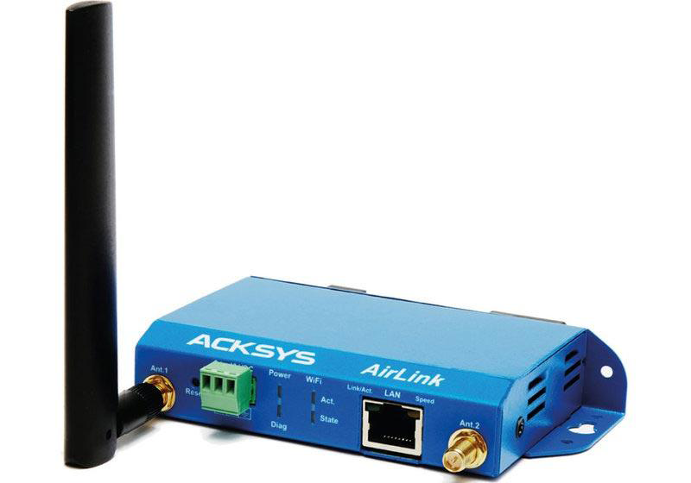
WLAN access point

Slide 22
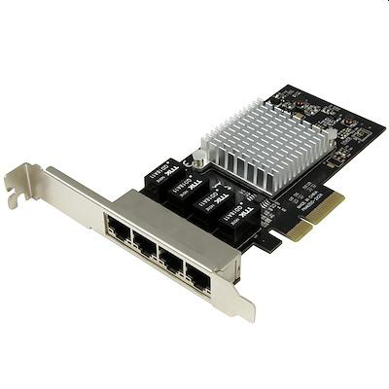
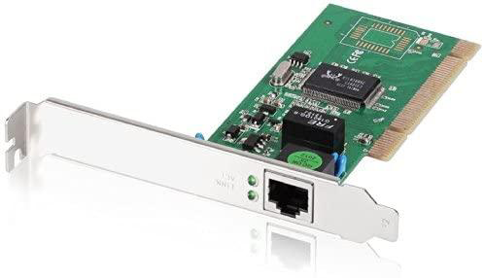
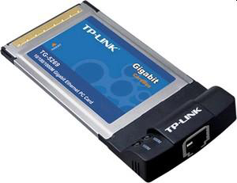
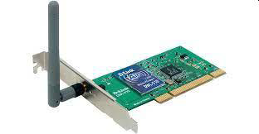
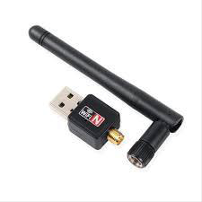
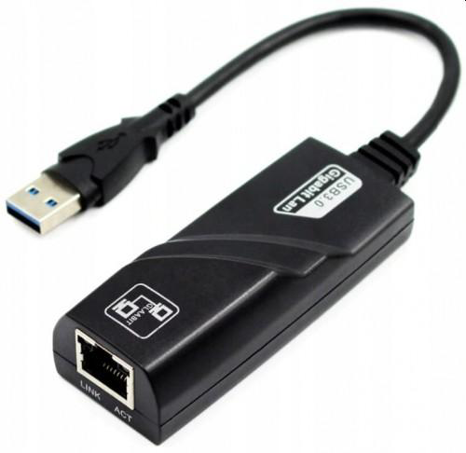
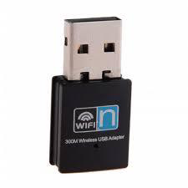
Network cards

Slide 23
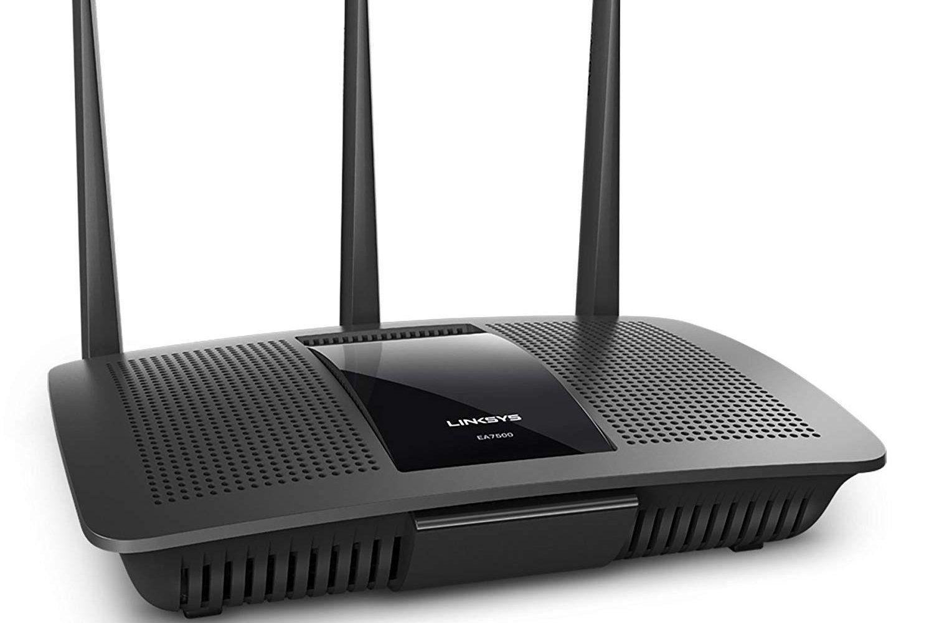
Router

Slide 24
TCP/IP-ISO/OSI model
The TCP/IP model is referred to as the protocol model.
Each of its layers performs specific tasks, for which specific protocols are used,
In the case of the TCP/IP model, we can distinguish 4 layers:
  applications,
  transport,
  Internet,
  network access.

Slide 25
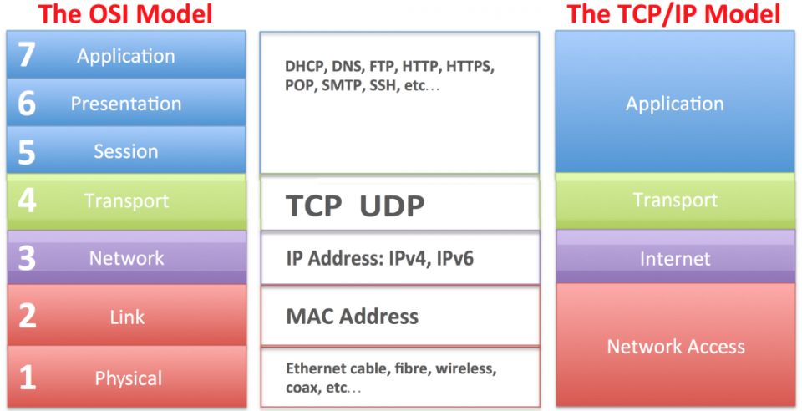
TCP/IP-ISO/OSI model

Slide 26
IP addressing
32 bits, 4 octets of 8 bits,
Binary numbering - for machines 10010101.01110010.10011111.00000011
Decimal numbering - for people 149.114.159.3

Slide 27
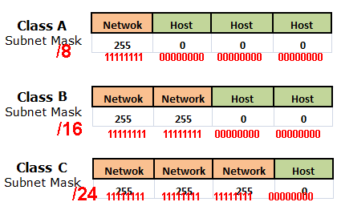
IPv4 classes

Slide 28
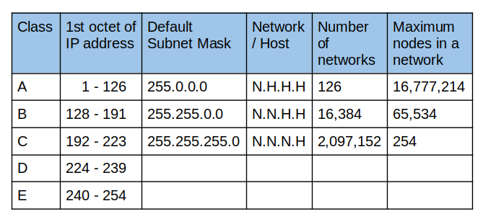
IPv4 classes

Slide 29
Network masks
The purpose of using the mask is to designate what part of the address identifies the network or subnetwork (NID) and which it identifies device within this subnet (HID)
The subnet address is logical IP address and mask conjunctions,
The mask is the same length as the IP address •(i.e. 32-bit for IPv4, 128-bit for IPv6)

Slide 30
The mask representation must consist of consecutive "1" bits starting from MSB
Correct
11111111.11111111.11111111.11000000
Incorrect
11111111.11111111.11111110.11000011

Slide 31
Network masks - notations
Full notation - all mask in binary or decimal
  11111111.11111111.11111111.00000000
  255.255.255.0
Shortcut - last octet only
  .128
Short record – number of "1" bits in the mask
  IP address/24
  149.156.114.3/24
"Triple" notation - means a class B network address
  149.156.x.x, all 1s in the address field and all 0s in the host id field {149.156,0,0}

Slide 32
NAT, Masquerading IPv4 addresses
A technique involving changing the source address of an IP packet to a different one.
Masquerading for selected classes of IPv4 addresses:
  for class A - addresses from the range
    10.0.0.0 -10.255.255.255
  for class B - addresses from the range
    172.16.0.0 -172.31.255.255
  for class C - addresses from the range
    192.168.0.0 -192.168.255.255

Slide 33
Wired communication media
Type of wired network cabling
Principles of building network connections

Slide 34
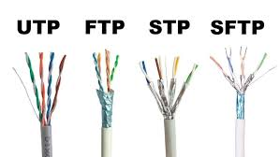
Structured cabling

Slide 35
Twisted pair type cable
The ISO/IEC 11801:2002 standard describes the method of describing twisted-pair cable.
According to the information contained therein, the cable description should have the following syntax: xx/yy TP, where yy describes a single pair of wires in the cable, and xx refers to the entire cable.
The designations accepted by xx and yy are:
  U –unshielded
  F – foiled
  S – shielded
  SF – shielded with foil and mesh
Common computer twisted pairs
  U/UTP – unshielded twisted pair
  F/UTP – foiled twisted pair
  U/FTP – twisted pair with each pair in a separate foil screen.
  F/FTP – twisted pair with each pair in a separate foil screen additionally in a foil screen
  SF/UTP – twisted pair shielded with foil and mesh
  S/FTP – twisted pair with each pair additionally foiled in a mesh screen
  SF/FTP – twisted pair with each pair additionally foiled in foil and mesh screen

Slide 36
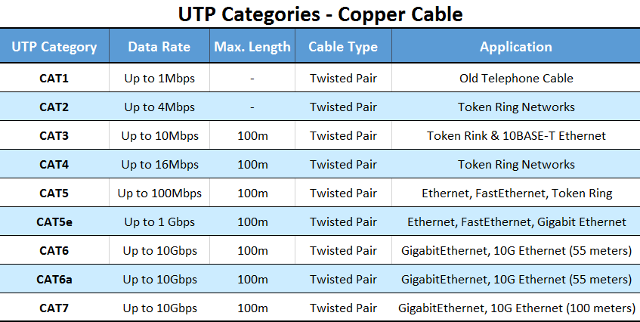
Categories and classes of twisted-pair cable

Slide 37
Specification of wire connections in RJ-45 plugs
There are two basic wire connection standards for 100Base-T networks:
  T568B (more commonly used)
  T568A

Slide 38
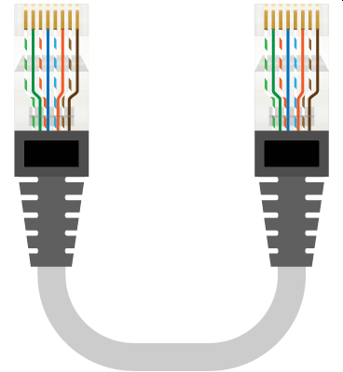
"Straight" cable - standard T568A

Slide 39
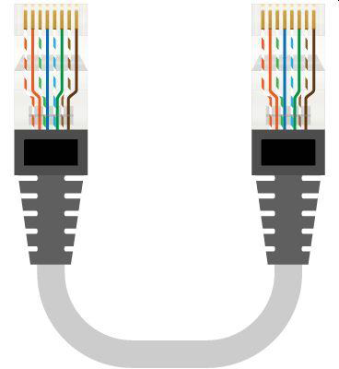
"Straight" cable - standard T568B

Slide 40
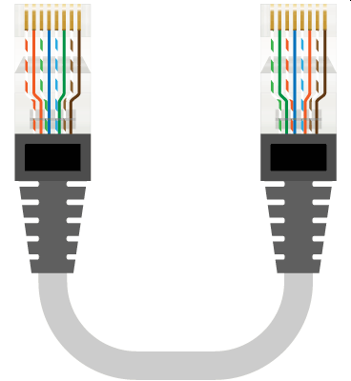
"Cross" type cable - a combination of T568A and T568B standards

Slide 41
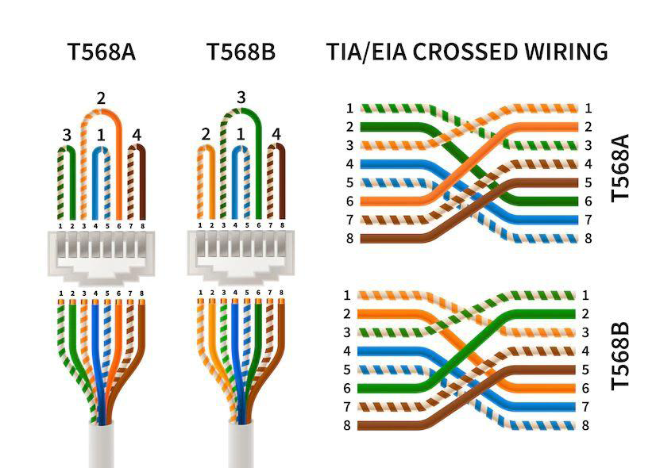
Cross connections for the same standard

Slide 42
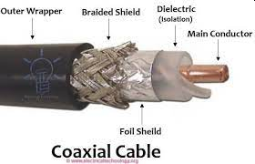
Coaxial coaxial cable

Slide 43
Coaxial coaxial cable
Two types of coaxial cable are commonly used – with a wave impedance of 50 and 75 Ohm, the former being used e.g. in computer networks.
Two types of coaxial cables have been used:
  Thin Ethernet (10Base-2 network) – RG-58 cable with a diameter of ¼” and a maximum network segment length of 185 m. Still used especially where there is a need for connection over a distance of more than 100 m.
  Thick Ethernet – (network type 10Base-5) – RG-8 and RG-11 cables with a diameter of ½” and a permissible segment length of 500 m. Not currently used, but it can still be found in very old networks.
  Both cables have a wave impedance of 50 Ohms.

Slide 44
Coaxial coaxial cable
It should be added that the impedance of the cable is closely related to the impedance of the devices connected to it. Therefore, one cannot use, for example, a TV antenna cable (with a wave impedance of 75 Ohm) in computer networks with impunity, because a network made in this way will probably simply not work.

Slide 45
Coaxial coaxial cable
Advantages: – it is not very sensitive to interference and noise; suitable for networks with modulated transmission (broadband) cheaper than shielded twisted cable Currently, coaxial cable is used only in very small networks (up to 3-4 computers) at the lowest possible cost.
The disadvantage of this solution is quite high (compared to twisted-pair network) failure rate of the installation. – It is also sometimes used to connect clusters of workstations wired in the star technology, especially where the distance between the hubs exceeds 100 m and it is not required to use speeds higher than 10 Mb/s.

Slide 46
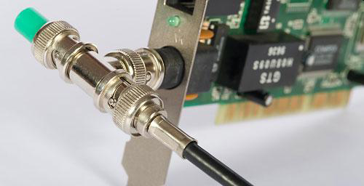
Network card with coaxial cable and terminator

Slide 47
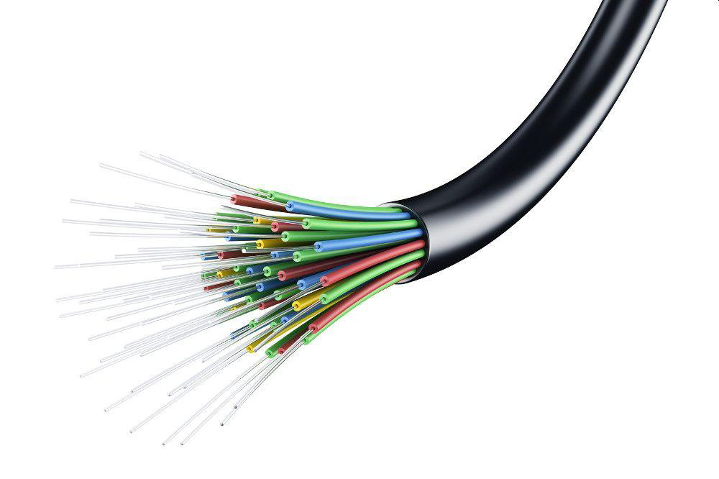
Fiber optic cable

Slide 48
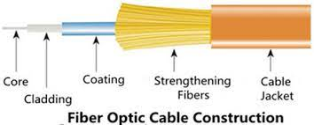
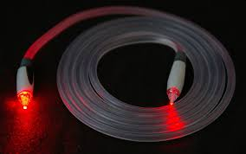
Fiber optic cable - construction

Slide 49
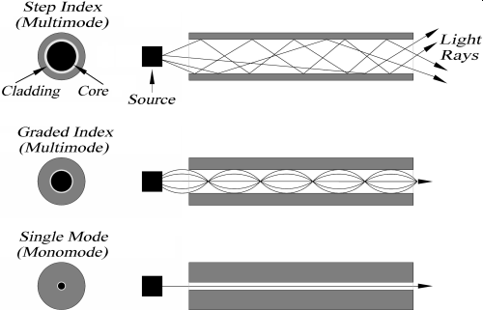
Types of fiber optic cables

Slide 50
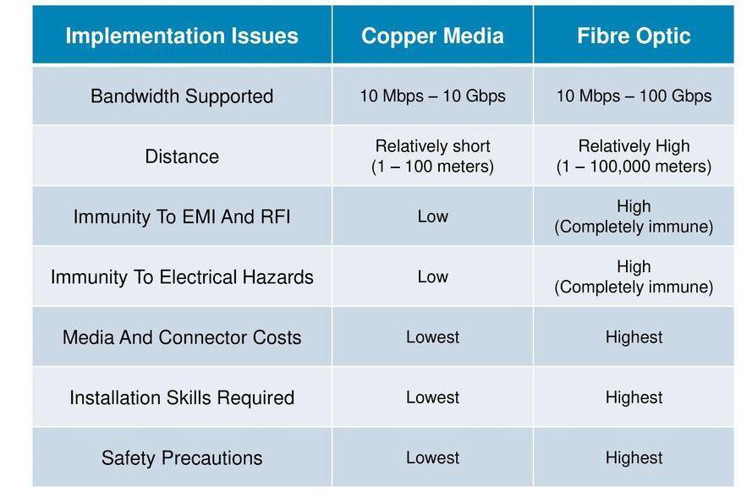
Comparison of cable networks

Slide 51
Routing IP
Routing Is a fixed set of ways to send packets from one network to another. This is one of the basic features of routers that enable data transfer over the Internet.

Slide 52
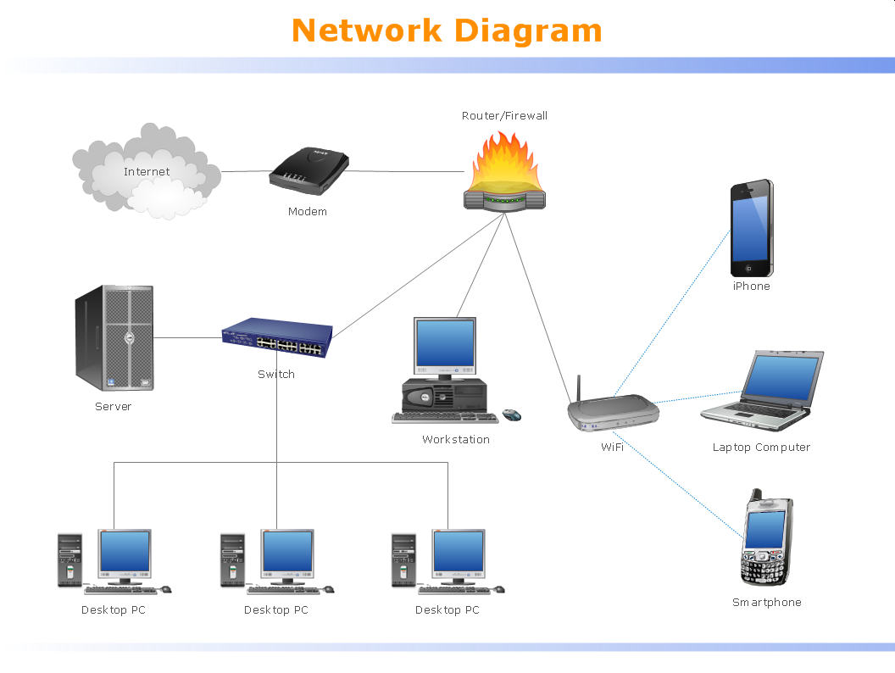
Example network

Slide 53
Static routing
Static routing refers to when network topology information and packet forwarding routes are hardcoded by the system administrator

Slide 54

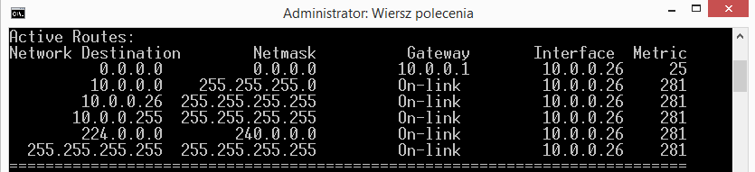

Static routing

Slide 55
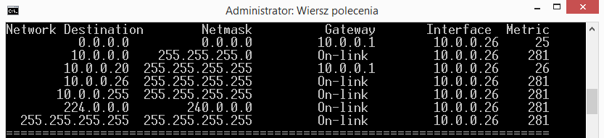
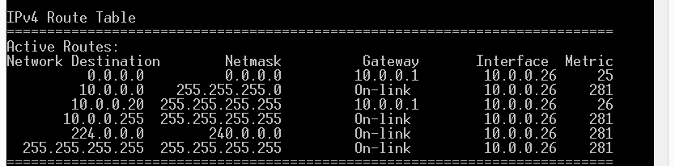
Static routing

Slide 56
Routing – default route
It is often necessary to enter the so-called default routes.
These are entries in the routing table that allow you to specify the path for packets for which the path has not been declared or dynamically determined

Slide 57

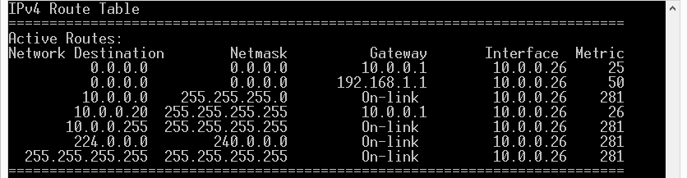
Routing – default route

Slide 58
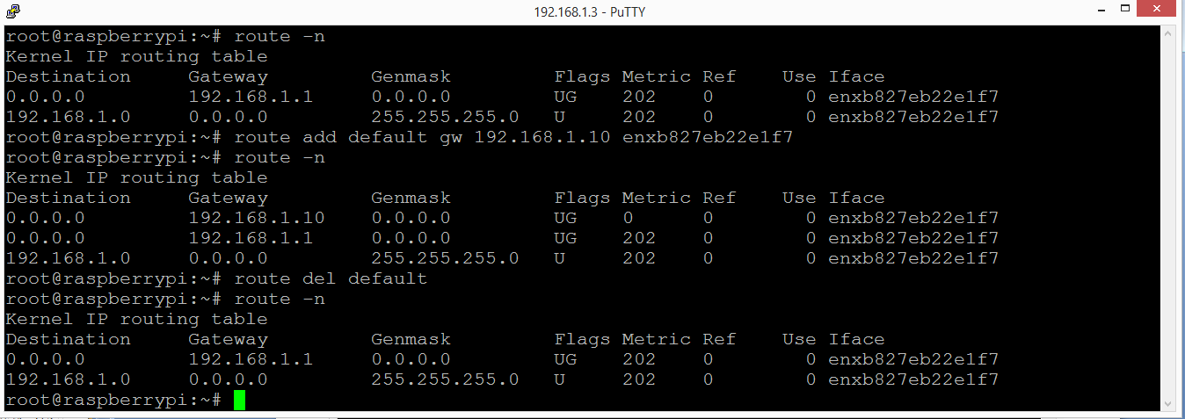
Routing – default route

Slide 59
Dynamic routing - types
The division according to the method of routing results from a different approach to creating information on routing.
In the case of distance vector protocols, the routing route is determined by finding the direction in which packets should be sent and determining the distance (number of router hops) to the packet destination network.

Slide 60
Dynamic Routing – selected protocols
Examples of routing protocols used are:
  RIP (RoutingInformationProtocol) version 1 and 2
  OSPF (OpenShortestPathFirst)
  BGP (BorderGatewayProtoco)
  IGRP (Interior GatewayRoutingProtocol)
  EIGRP (EnhancedIGRP)

Slide 61
Routing - ways to avoid loops
In the case of alternative routes, routing routes may loop, resulting in packets not being sent.
In order to prevent this negative phenomenon, various methods are used to eliminate such events.
This issue is specific to RIP.

Slide 62
Routing - ways to avoid loops
One of them is the split horizon method. This method prevents a router that has sent information about a given network from receiving information about that network from other routers.
Another method to eliminate loops is blocking (poisoning) the route (routepoisoning). A router that detects that its adjacent network is unavailable stores the route in its routing table as unavailable (metric=16) and sends updates to neighboring routers. It blocks ("poisons") the route to this network for other routers.

Slide 63
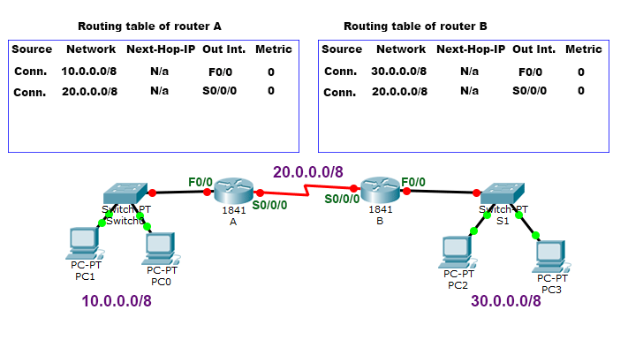
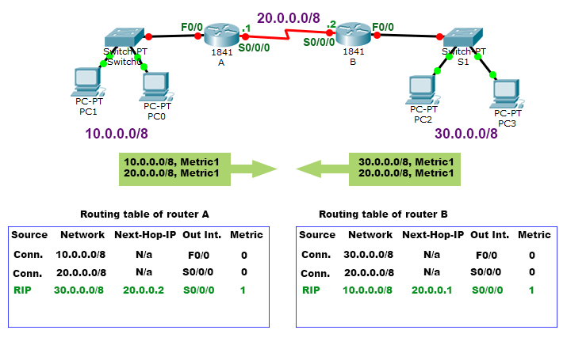
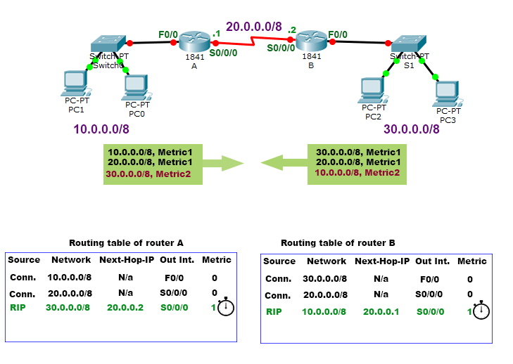
Routing - ways to avoid loops
Split Horizontal

Slide 64
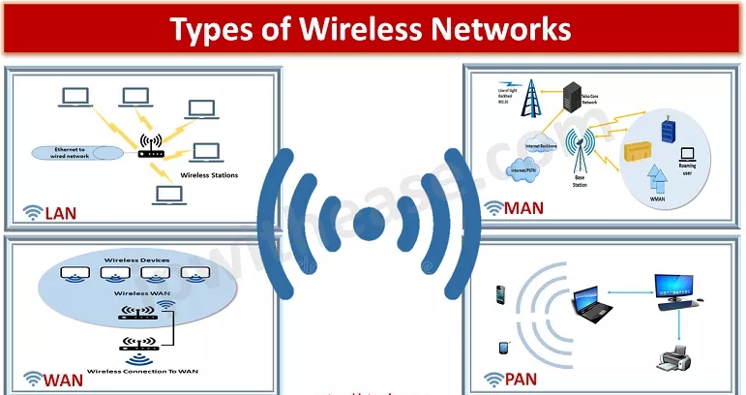
WLAN wireless network technologies
a way of communication in which we use radio waves as a transmission medium

Slide 65
Frequency ranges of wireless networks
Wireless networks operate based on the propagation of electromagnetic waves. For this reason, they are one of the ways of transferring information in a strictly defined frequency band.
Three generally available commercial bands have been adopted worldwide.
These bands are marked ISM (industrial, scientific, and medical):
  UHF ISM 902-928MHz
  S-Band ISM–2.4 to 2.5GHz
  C-Band ISM-5.725-5.875GHz.
Wireless networks use dedicated bands reserved for this type of communication

Slide 66
Radio communication frequency ranges
Band Range
UHF ISM 902 –928 MHz
S-Band 2-4 GHz
S-Band ISM 2.4 –2.5 GHz
C-Band 4 –8 GHz
C-Band satellitedownlink 3.7 –4.2 GHz
C-Band Radar (weather) 5.25 –5.925 GHz
C-Band ISM 5.725 –5.875 GHz
C-Band satelliteuplink 5.925 –6.425 GHz
X-Band 8 –12 GHz
X-Band Radar (police/ weather) 8.5–10.55 GHz
Ku-Band 12 –18 GHz
Ku-Band Radar(police) 13.4 –14 GHz15.7 –17.7 GHz

Slide 67
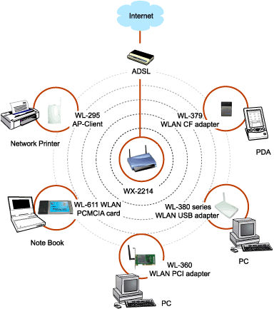
Basic components of wireless networks

Slide 68

802.11 standards - summary
Name Trans. Speed Frequency Signal type Comments

Slide 69
Wireless network security
Wireless networks, due to their principle of operation, are networks with a shared transmission medium.
So any problems related to such signal transmission also occur here.
Due to the widespread use of devices using wireless networks, various types of security have been introduced, including:
  WEP
  TKIP
  WPA
  802.1X
  VPN
  NAC

Slide 70
Threat analysis - tools
One of the basic problems related to the use of wireless networks is the issue of security.
There are many specialized programs that can be used to detect vulnerabilities in existing systems.
Examples of such programs include:
  Ethereal
  Kismet
  Airsnarf
  Airsnort
  Aircrack
  Wireshark

Slide 71

Ethereal

Slide 72


Kismet

Slide 73

Airsnort

Slide 74

Aircrack

Slide 75

Wireshark

Slide 76
Thank you for your attention

